Slide 1
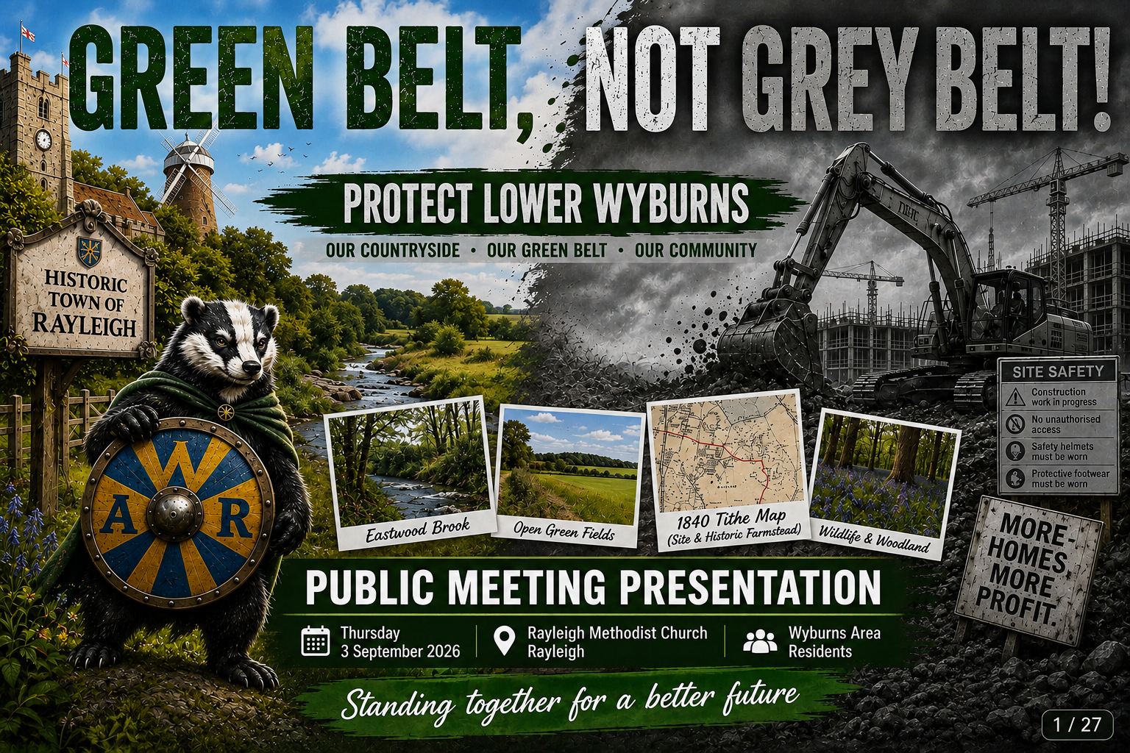
1 / 34

Slide 2

WHY WE ARE HERE
2 / 34
• Not against housing
• Against the wrong development
• Is it appropriate?
• Is it sustainable?
• Is it deliverable?
Wyburns Area Residents - public meeting presentation

Slide 3
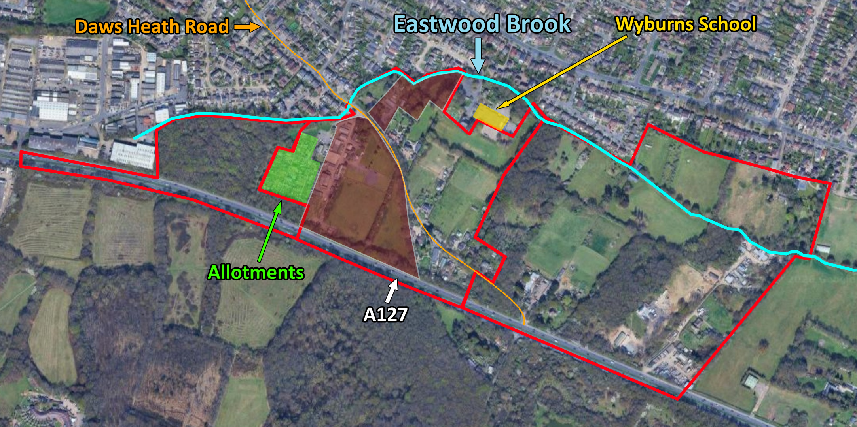

WHERE IS LOWER WYBURNS?
3 / 34
• Daws Heath Road
• A127
• Northern + southern parcels
• Eastwood Brook
• Allotments + woodland
Wyburns Area Residents - public meeting presentation

Slide 4
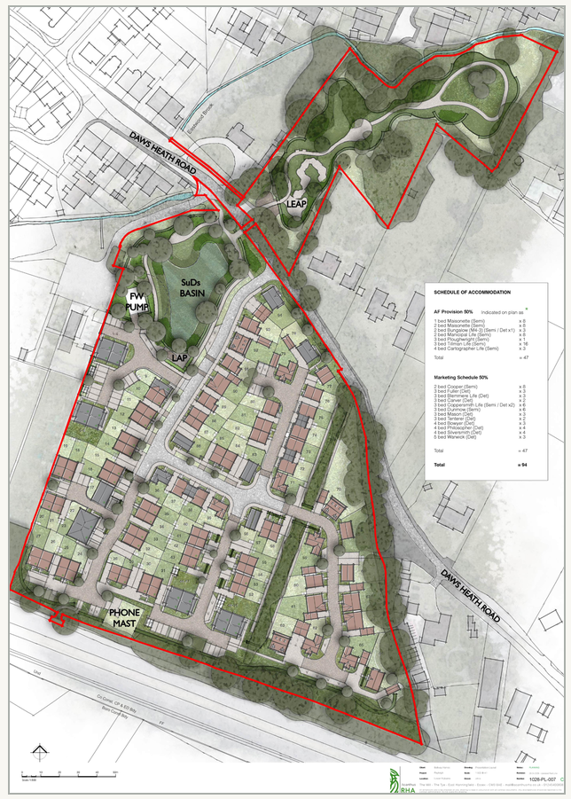

WHAT IS PROPOSED?
4 / 34
• 94 homes
• New access
• Southern parcel built on
• Northern parcel open space
• 201 parking spaces
Wyburns Area Residents - public meeting presentation

Slide 5


WHO IS DOING THIS?
5 / 34
Wyburns Area Residents - public meeting presentation

Slide 6


TWO ACTIONS TONIGHT
5 / 34
• Object to the planning application 26/00538/FUL
• Email councillors about the green belt assessment
• These are two separate processes
• Please do both
Wyburns Area Residents - public meeting presentation

Slide 7
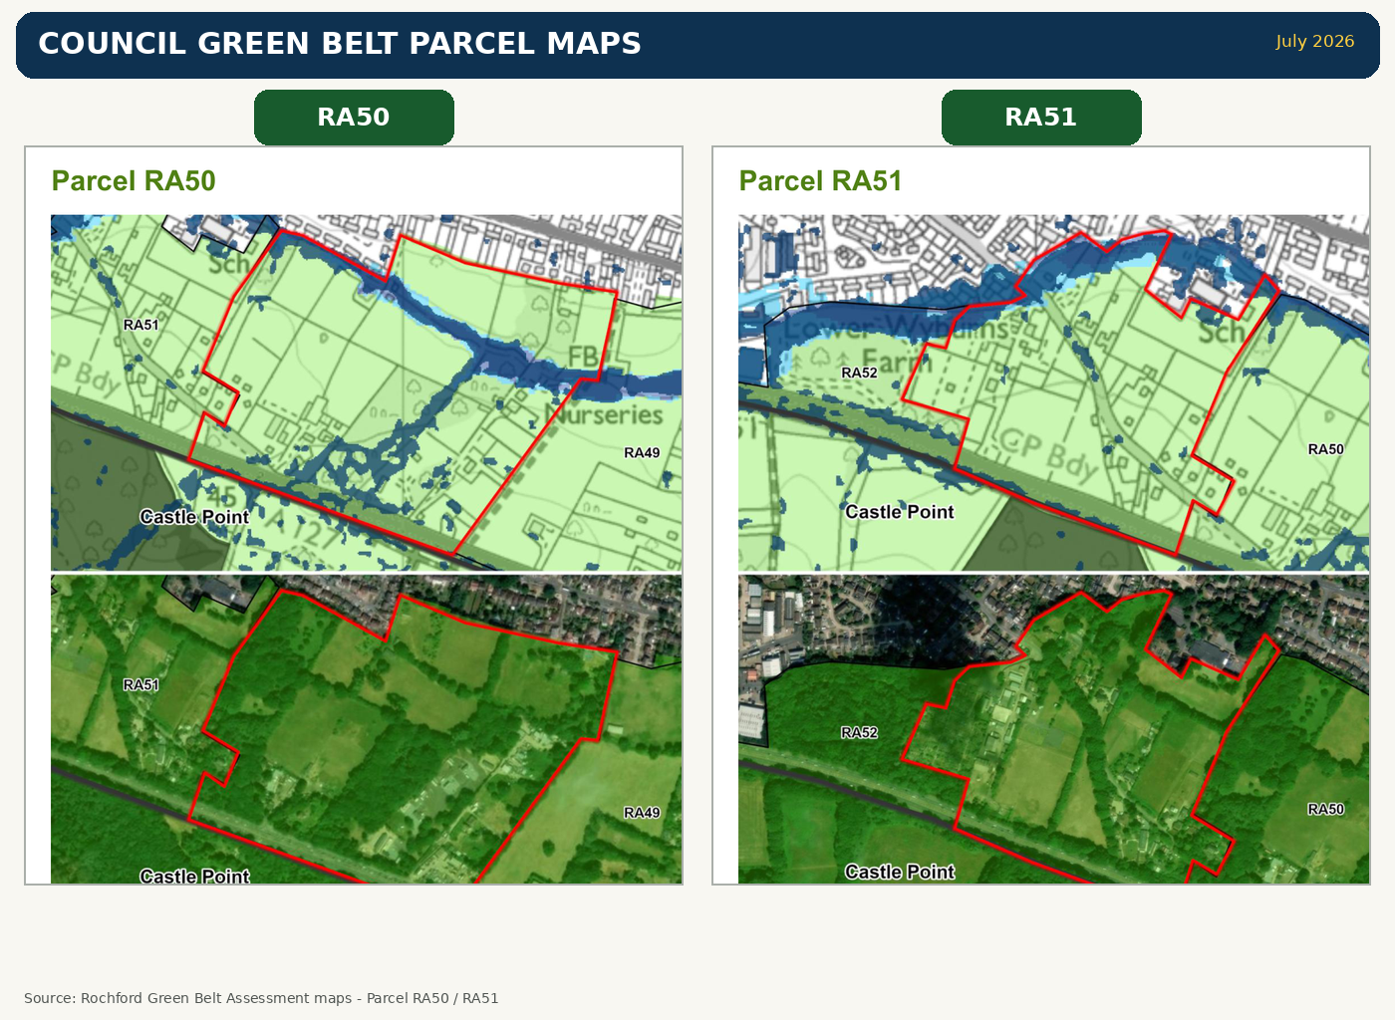
GREEN BELT ASSESSMENT
6 / 34
• RA50 / RA51 concern
• Potential grey belt disputed
• Brook + boundaries missed
• Reassessment requested
Wyburns Area Residents - public meeting presentation

Slide 8
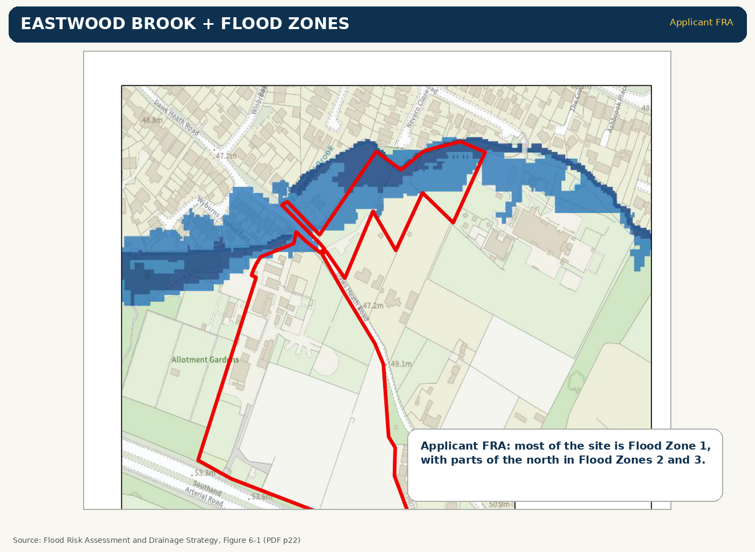

EASTWOOD BROOK
7 / 34
• Environment Agency Main River
• Not named in RA51 reasoning
• RA50: “small water course”
• Boundary role not tested
Wyburns Area Residents - public meeting presentation

Slide 9
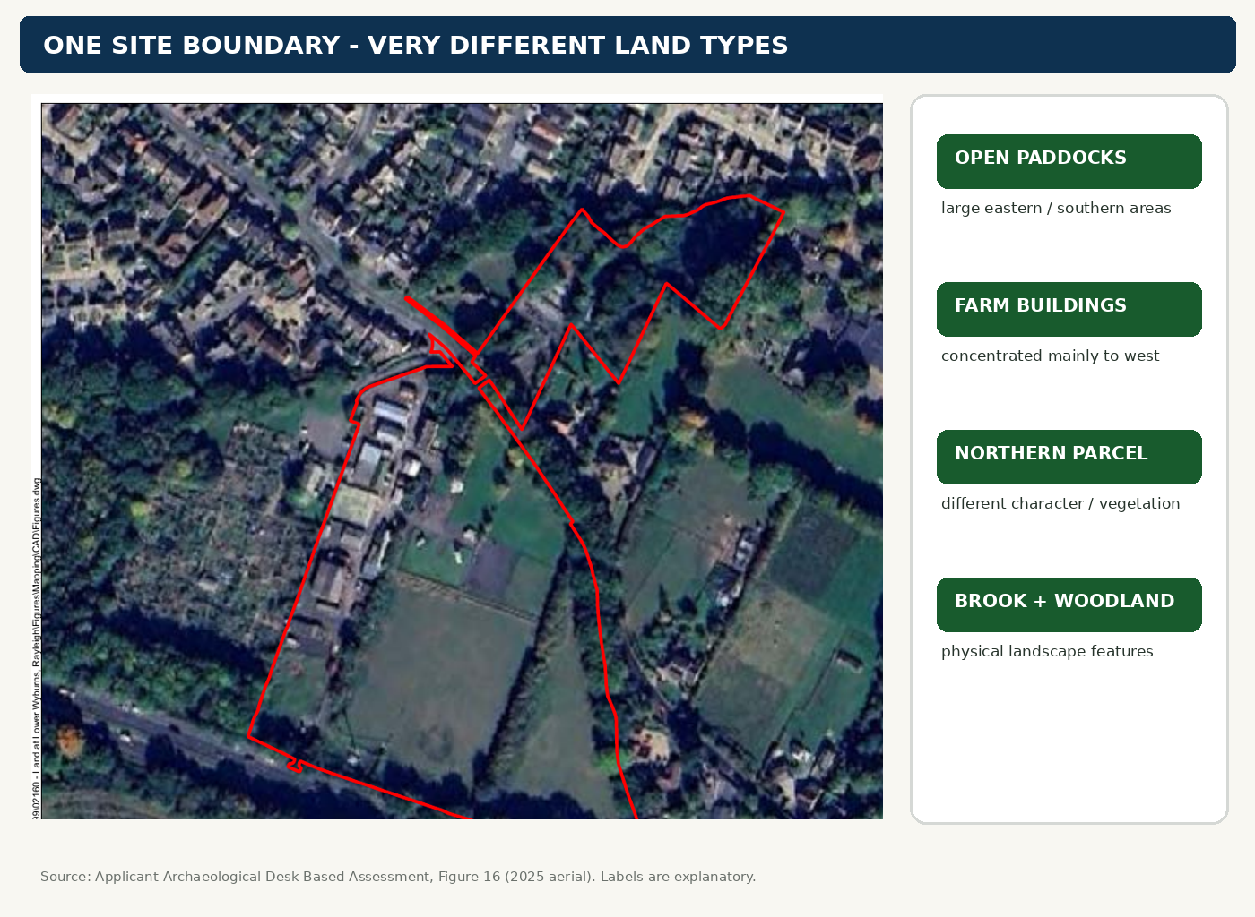
FAIR PARCEL DIVISION
8 / 34
• Different land types
• Open fields ≠ developed corners
• Avoid averaging
• Assess sections fairly
Wyburns Area Residents - public meeting presentation

Slide 10
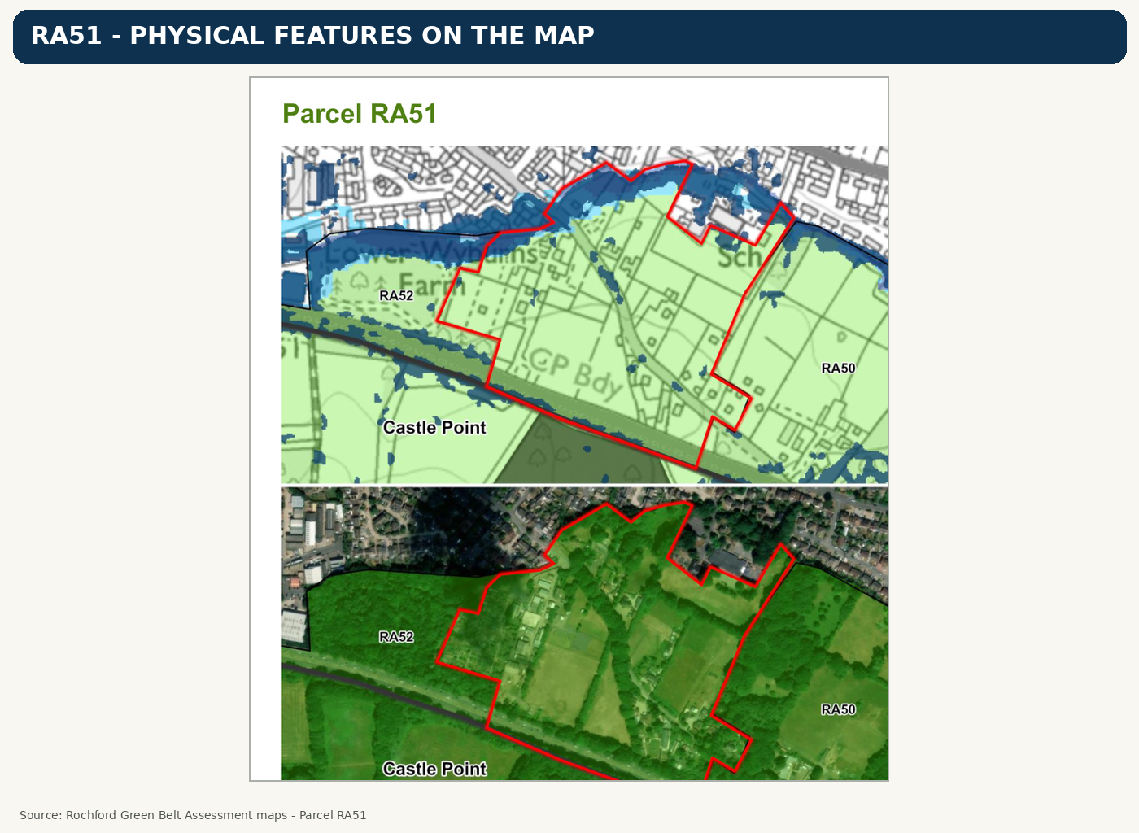
USE REAL BOUNDARIES
9 / 34
• Brook
• Woodland
• Vegetation
• Roads
• Settlement edge
Wyburns Area Residents - public meeting presentation

Slide 11
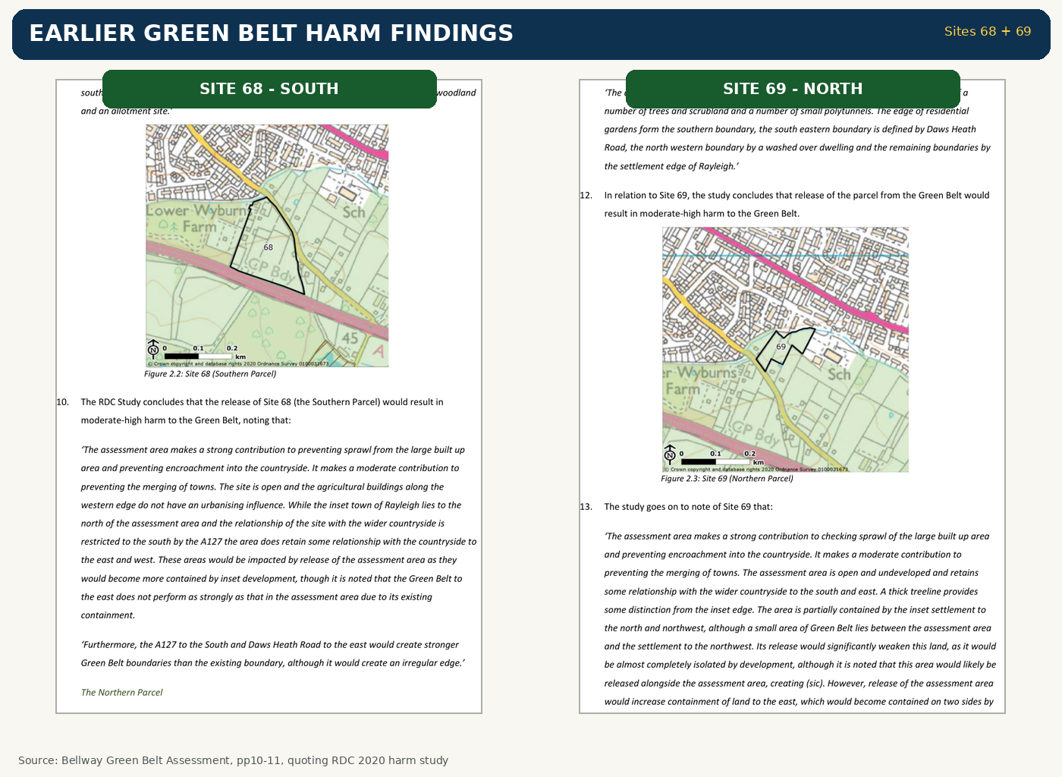

WHY DID THE RATING CHANGE?
10 / 34
• 2020: moderate-high harm
• Strong sprawl role
• Strong encroachment role
• 2026 conclusion changed
Applicant Green Belt Assessment pp10-11 reproducing earlier RDC harm findings for Sites 68 and 69.
Wyburns Area Residents - public meeting presentation

Slide 12
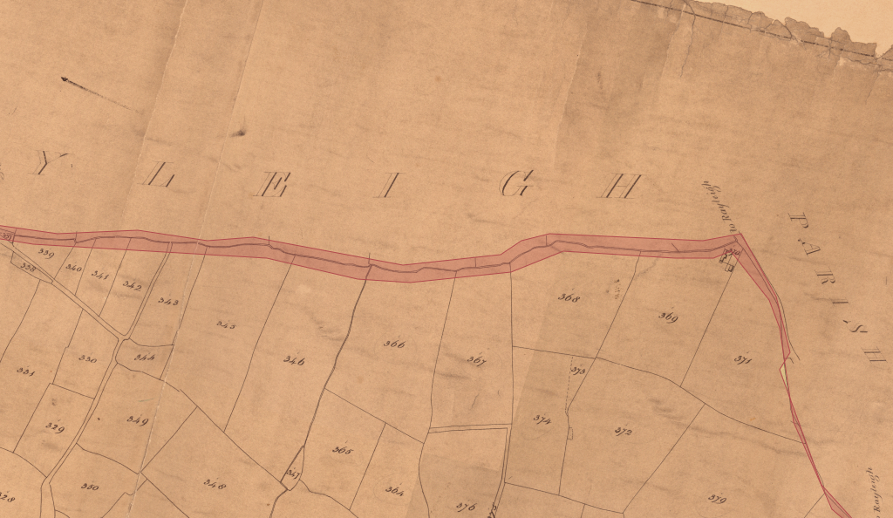
HISTORIC LANDSCAPE
11 / 34
• Historic farmstead
• Old boundaries
• Historic routeways
• Brook corridor
• Specialist review needed
Wyburns Area Residents - public meeting presentation

Slide 13
HOW DID WE GET HERE?
12 / 34
Documented site-history chronology - not a complete Land Registry title chain
1841-42
Tithe maps: mostly open / arable land; homestead recorded.
Stonehewer / Downes parcels
1873-1972
“Wyburns” becomes “Lower Wyburns”; farmstead changes gradually.
Applicant Archaeological DBA
1991-2019
Horticultural / farm uses continue; Stokes name appears in public farm and landowner records.
RDC + Essex public records
2017-18
CFS068 / CFS069 assessed in SHELAA; site promoted again through Call for Sites.
RDC Local Plan evidence
2021
Southern & Regional Developments says it is “in control” and promotes housing allocation.
RDC Spatial Options representation
2022
Bellway Homes takes 75%+ control of Southern & Regional; company later renamed Woolsington One.
Companies House 10470626
2026
Pre-application + 31 Mar consultation → 94-home application received 24 Jul, validated 11 Aug.
Applicant / RDC records
Sources: applicant Archaeological DBA; RDC planning / Local Plan records; Essex landowner deposits; Companies House; application 26/00538/FUL.

Slide 14
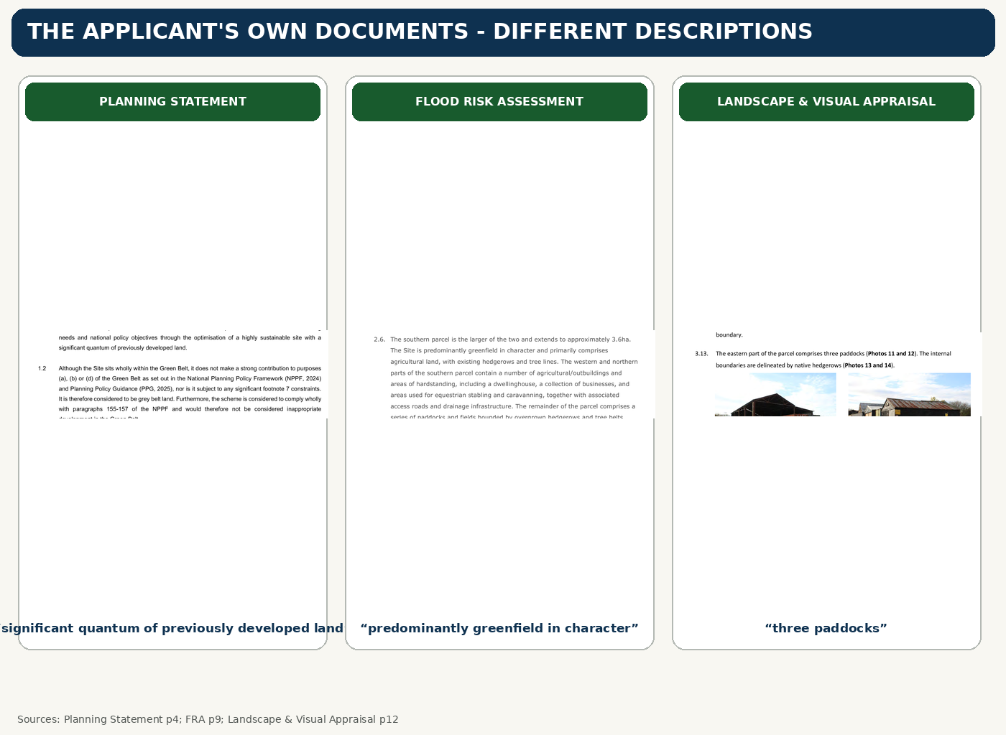
PREVIOUSLY DEVELOPED LAND?
13 / 34
• Planning Statement: “significant” PDL
• Flood report: “predominantly greenfield”
• Landscape report: “three paddocks”
• Exactly which parts qualify as PDL?

Slide 15
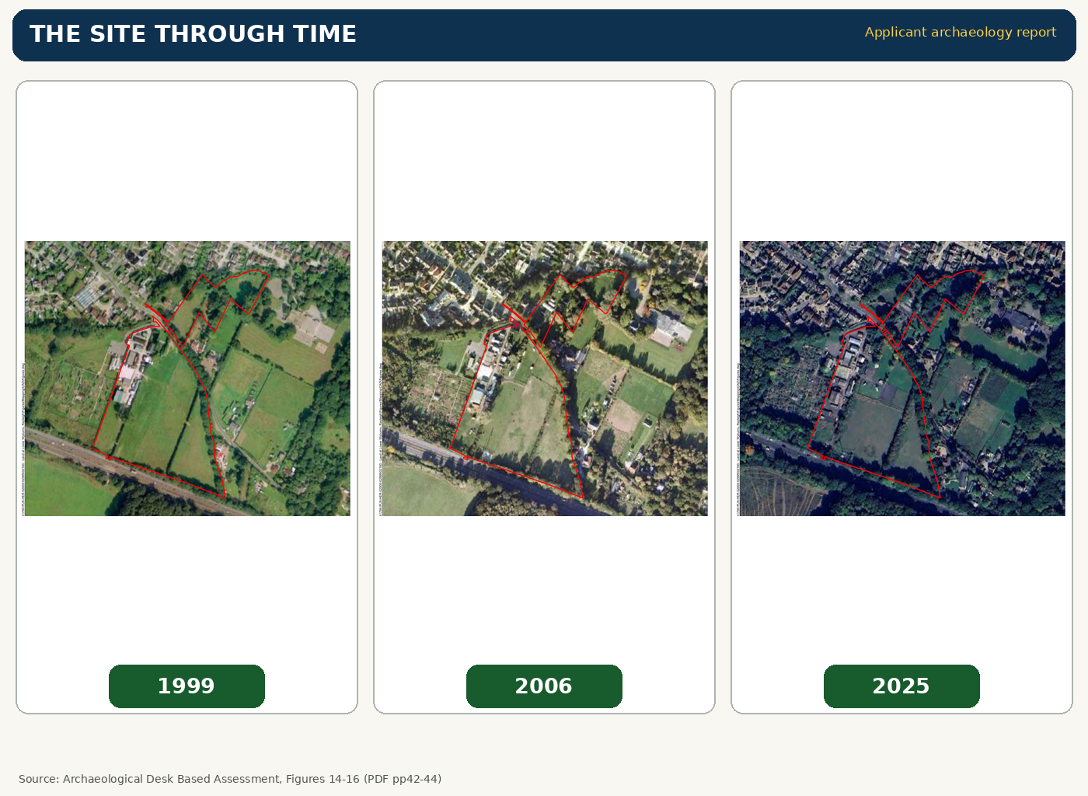
THE SITE THROUGH TIME
14 / 34
• 1999: open land + farm buildings to NW
• 2006: structures appear north of road
• 2025: farm buildings expand eastwards
• Large open areas remain visible

Slide 16
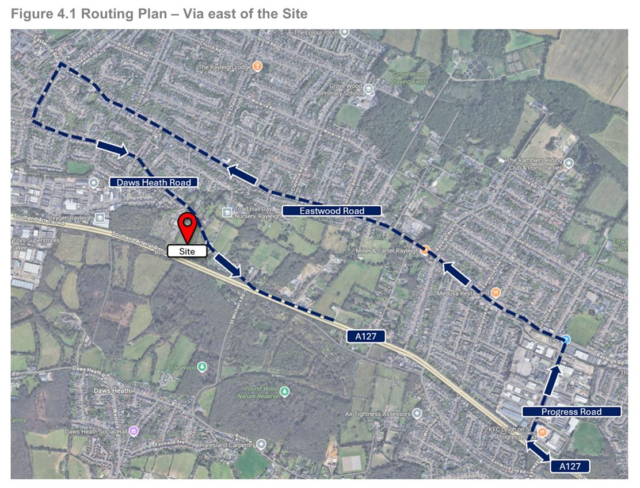
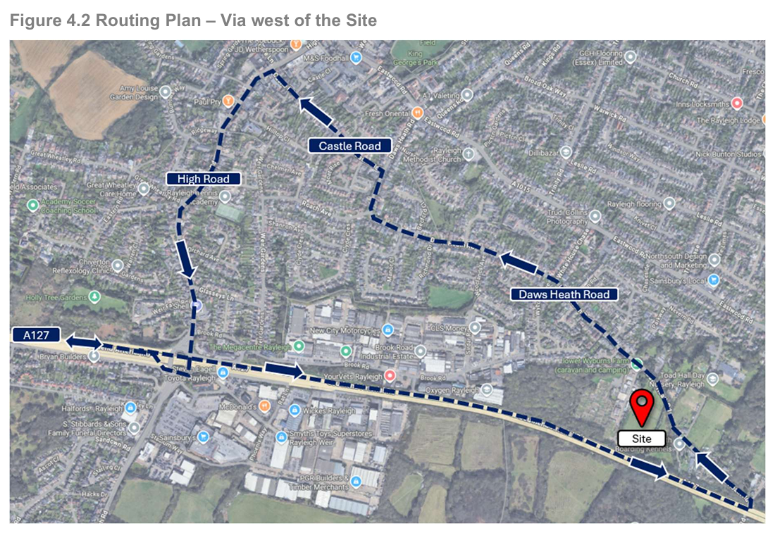
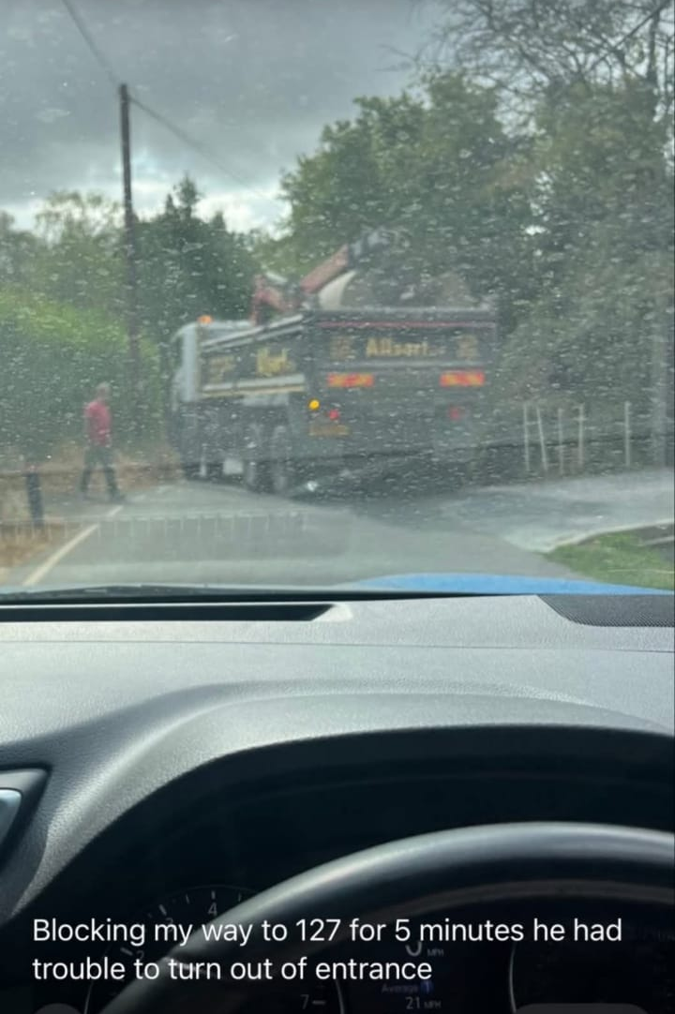

CONSTRUCTION TRAFFIC
15 / 34
Applicant Construction Management Plan, vehicle route figures / construction programme.
• HGV routes
• Daws Heath Road
• Residential streets
• Approx. two years

Slide 17
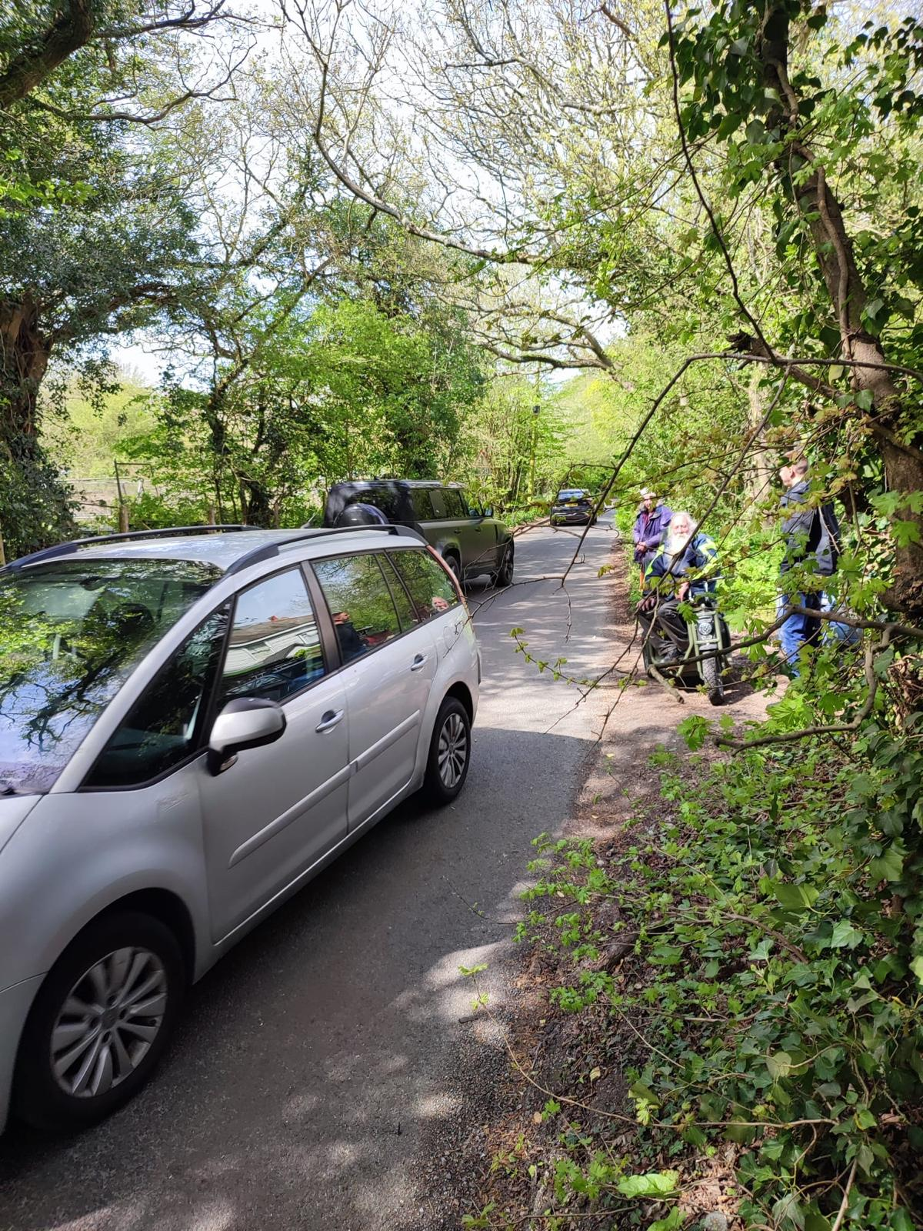
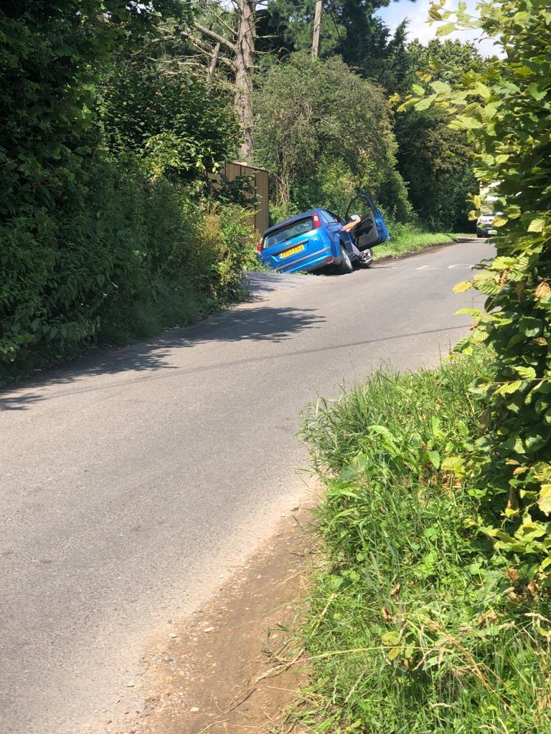
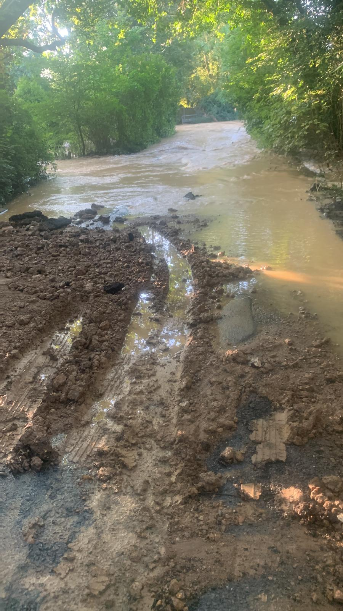
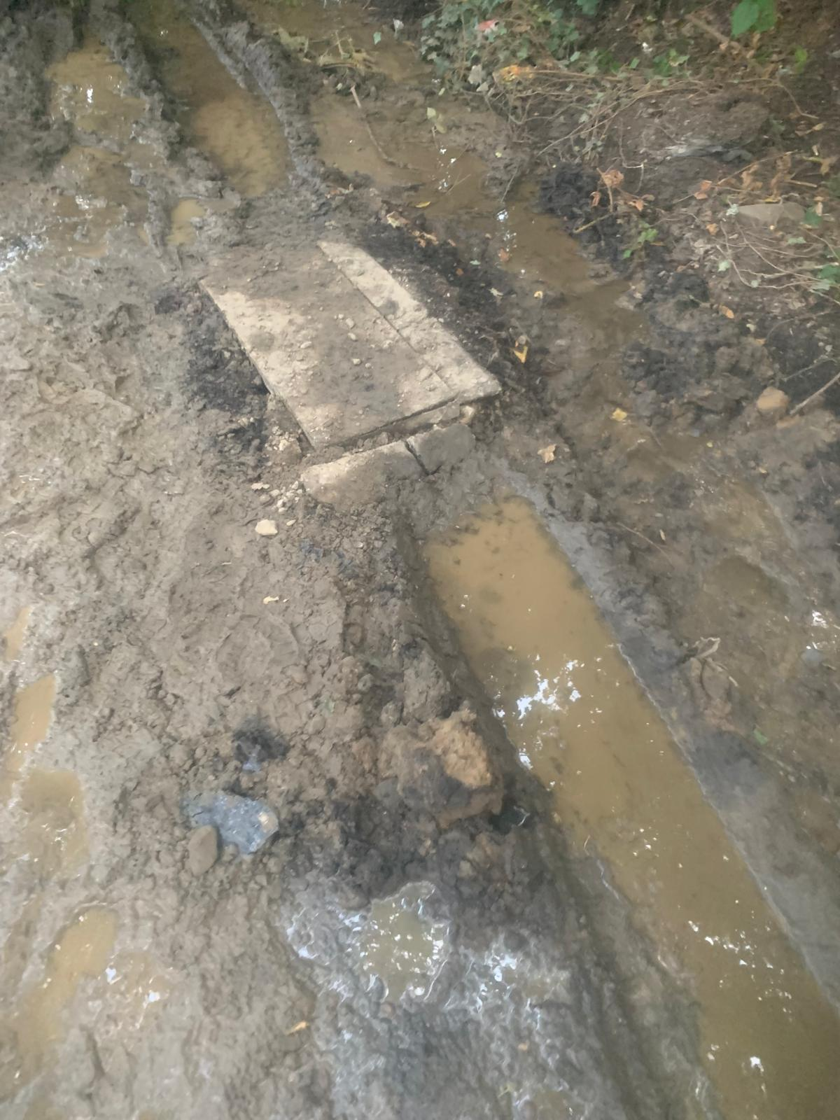
DAWS HEATH ROAD REALITY
16 / 34
• ~4.3 m rural lane
• No continuous footway
• Verge overrun
• Pedestrians + mobility scooters

Slide 18
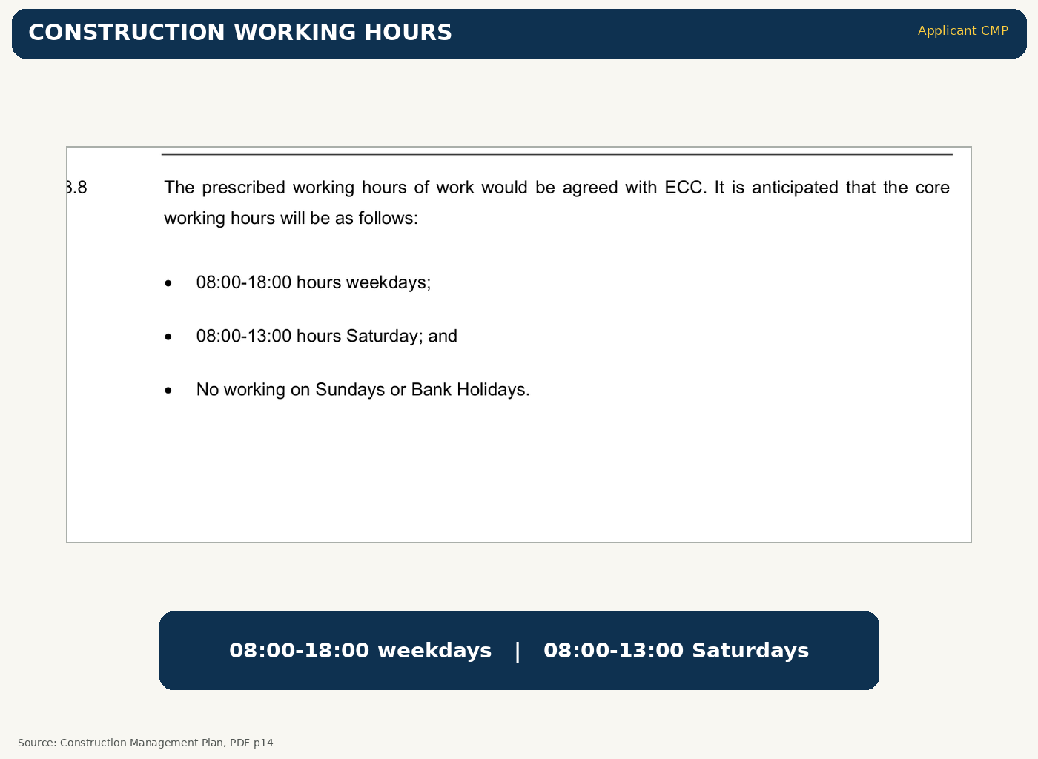

WORKING HOURS + DARKNESS
17 / 34
• 08:00–18:00 weekdays
• 08:00–13:00 Saturdays
• Winter darkness
• No street lighting

Slide 19
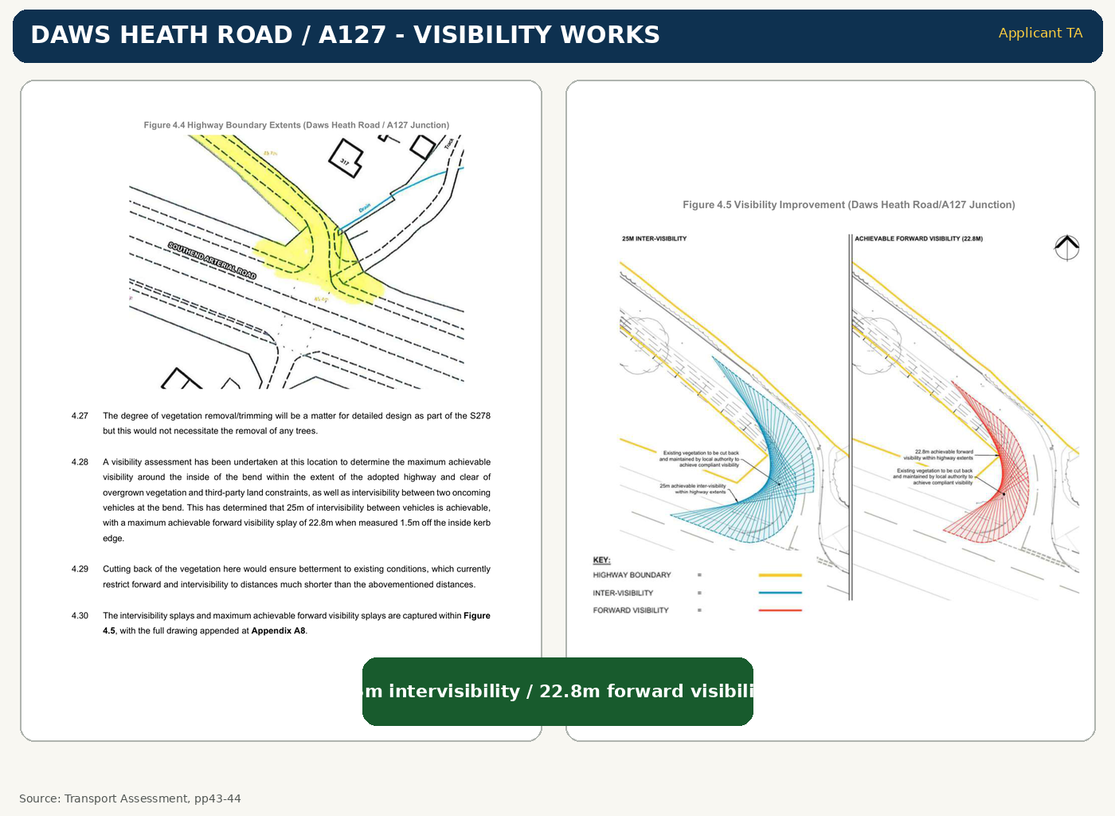
JUNCTIONS + PINCH POINTS
18 / 34
• A127 hairpin concern
• Castle Road / tip congestion
• Parked cars
• Passing difficulty

Slide 20
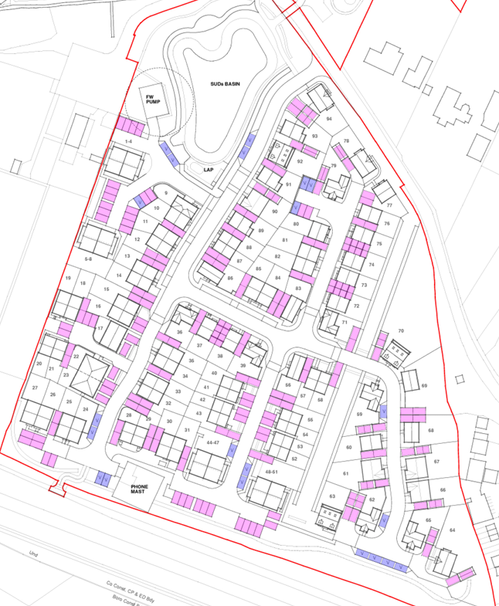
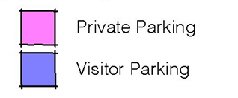
PERMANENT TRAFFIC
19 / 34
• 94 homes
• 201 parking spaces
• Car ownership expected
• Sustainable on paper?
Wyburns Area Residents - public meeting presentation

Slide 21
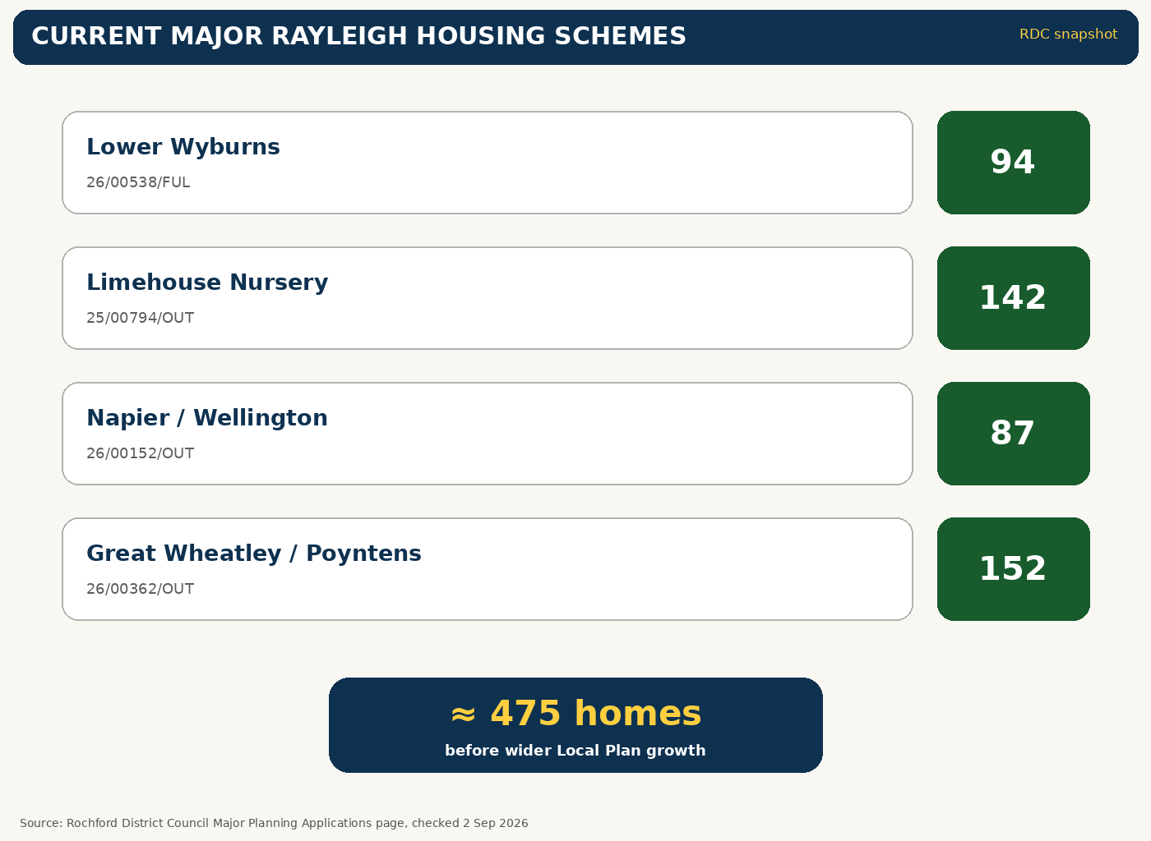
CUMULATIVE IMPACT
20 / 34
• Lower Wyburns: 94
• Limehouse: 142
• Napier/Wellington: 87
• Great Wheatley: 152
• ≈475 homes
Wyburns Area Residents - public meeting presentation

Slide 22
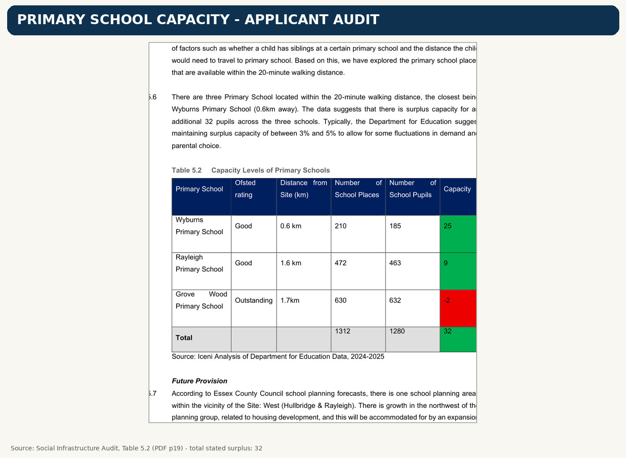
SCHOOLS + SERVICES
21 / 34
• Applicant audit: 32 spare primary places
• Those places are shared capacity
• Other major Rayleigh schemes: ≈475 homes
• Cumulative demand matters
Wyburns Area Residents - public meeting presentation

Slide 23

FLOOD RISK + BROOK
22 / 34
• Eastwood Brook = EA Main River
• Flood Zones 2 + 3 in northern area
• Surface-water evidence needs careful testing
• Downstream effects matter
Wyburns Area Residents - public meeting presentation

Slide 24
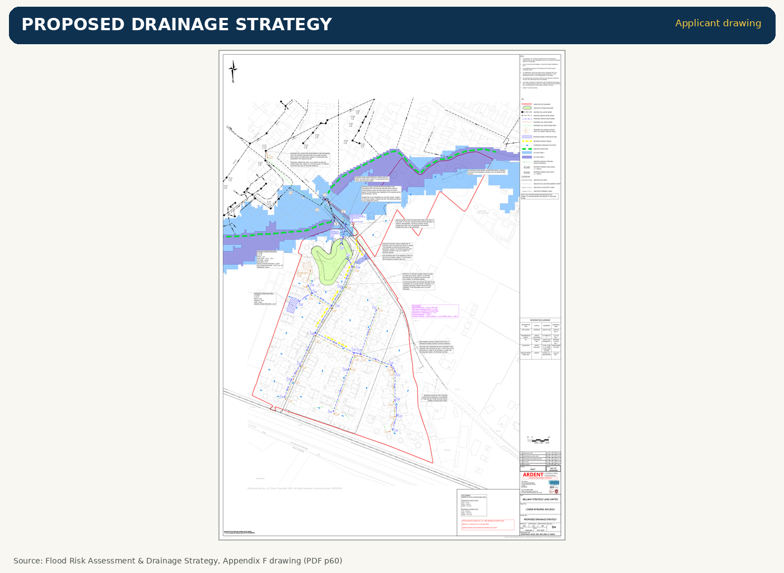
WHAT SUDS DOES
23 / 34
• Collects rainfall
• Stores it temporarily
• Slows discharge
• Ultimately to Eastwood Brook
Wyburns Area Residents - public meeting presentation

Slide 25
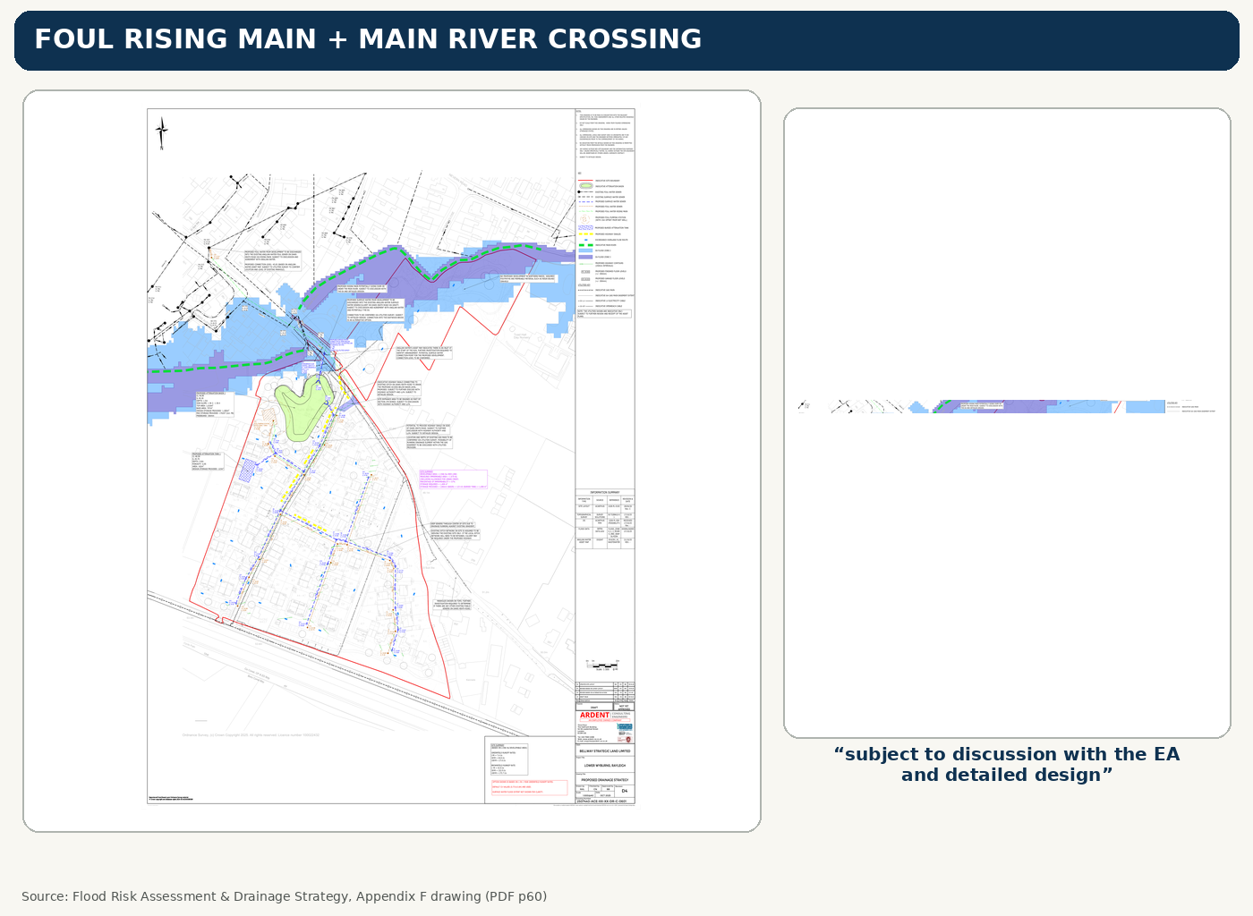

FOUL PUMPING STATION
24 / 34
• Foul sewage pumped separately
• Rising main crosses the Brook corridor
• Over or under Main River still to be designed
• EA discussion still required
“PROPOSED RISING MAIN POTENTIALLY GOING OVER OR UNDER THE MAIN RIVER.”
“SUBJECT TO DISCUSSION WITH THE EA AND DETAILED DESIGN.”
Wyburns Area Residents - public meeting presentation

Slide 26
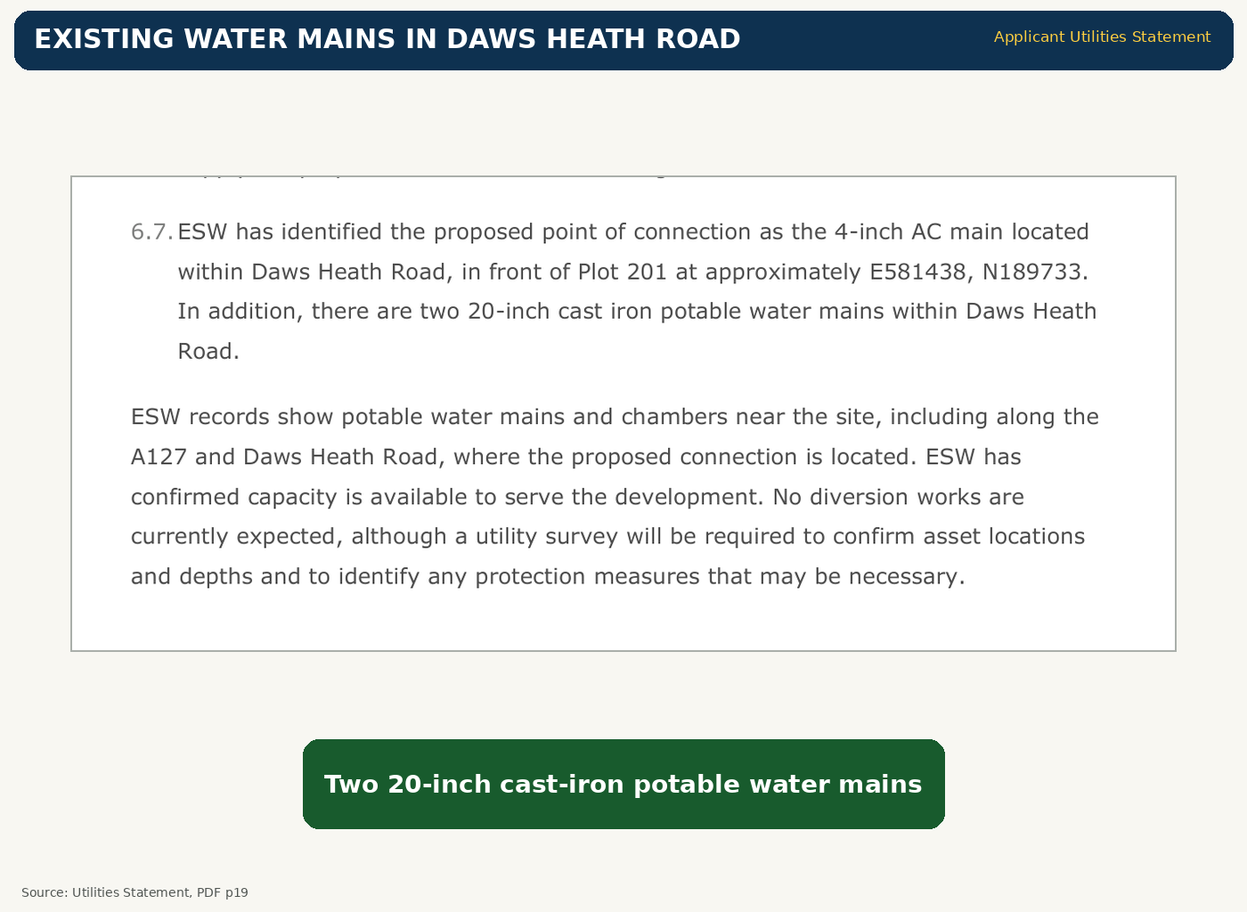
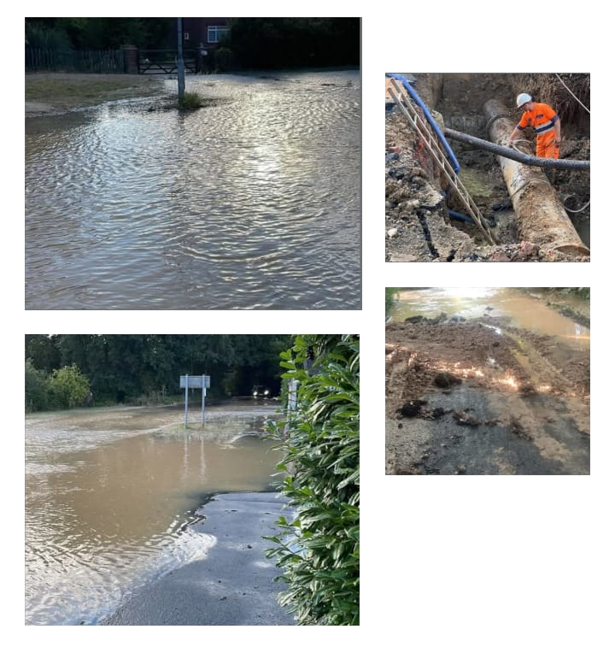
OLD WATER MAINS
25 / 34
• Large cast-iron mains
• Known local failures
• Road closures
• HGV route resilience?
Wyburns Area Residents - public meeting presentation

Slide 27
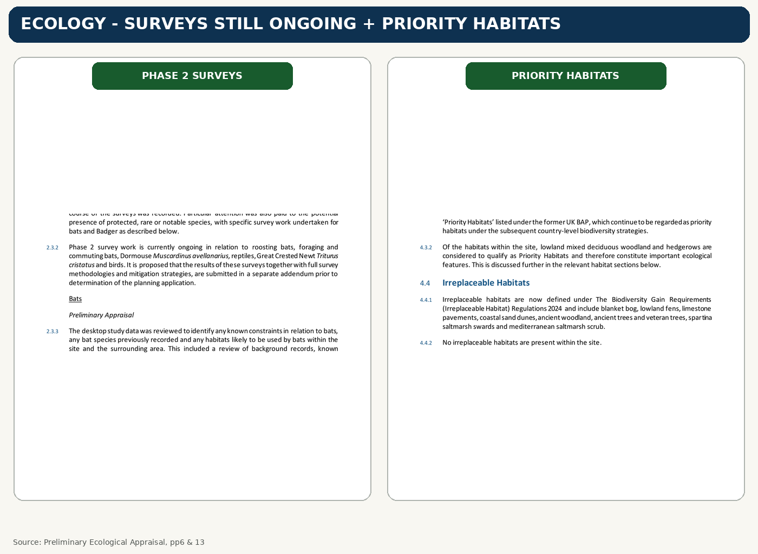
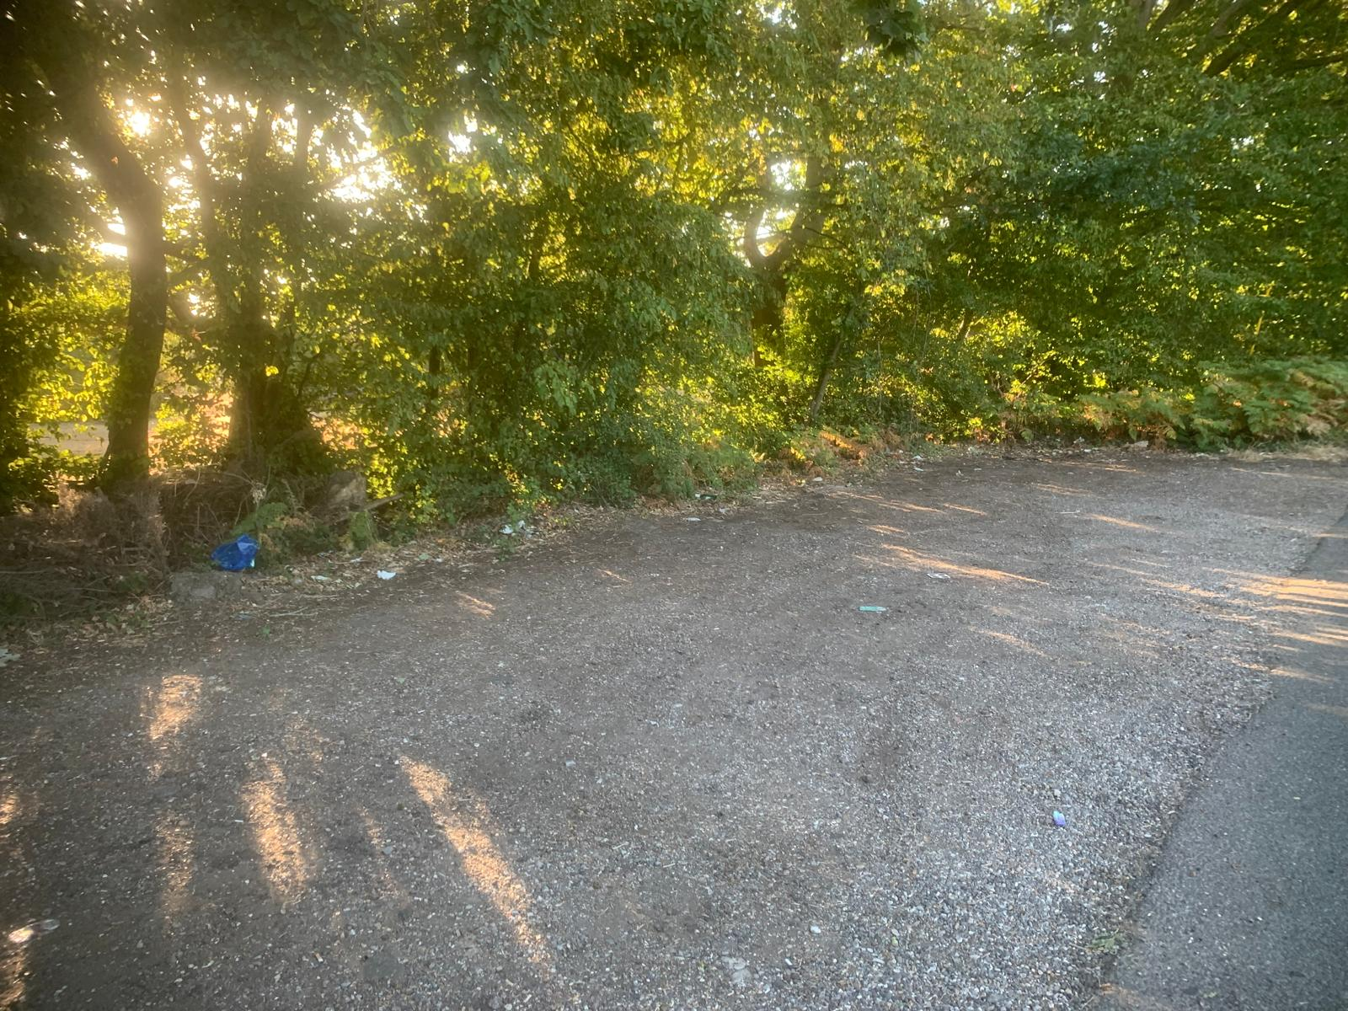
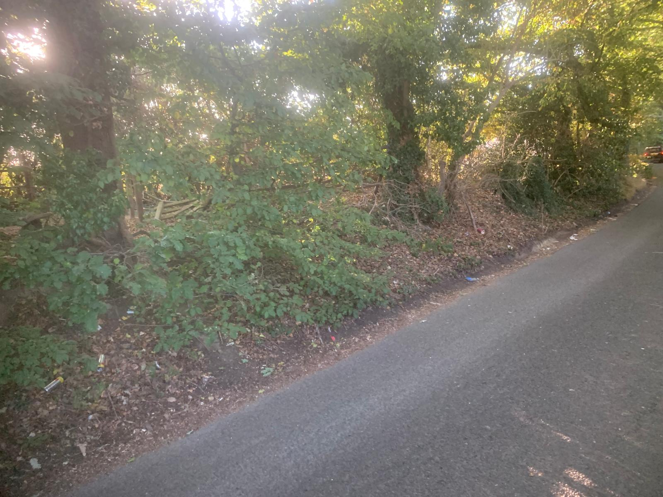

ECOLOGY + WILDLIFE
26 / 34
• Priority Habitat woodland + hedgerows
• Further species surveys identified
• Bats, dormouse, reptiles, GCN, birds
• Survey evidence must be complete

Slide 28
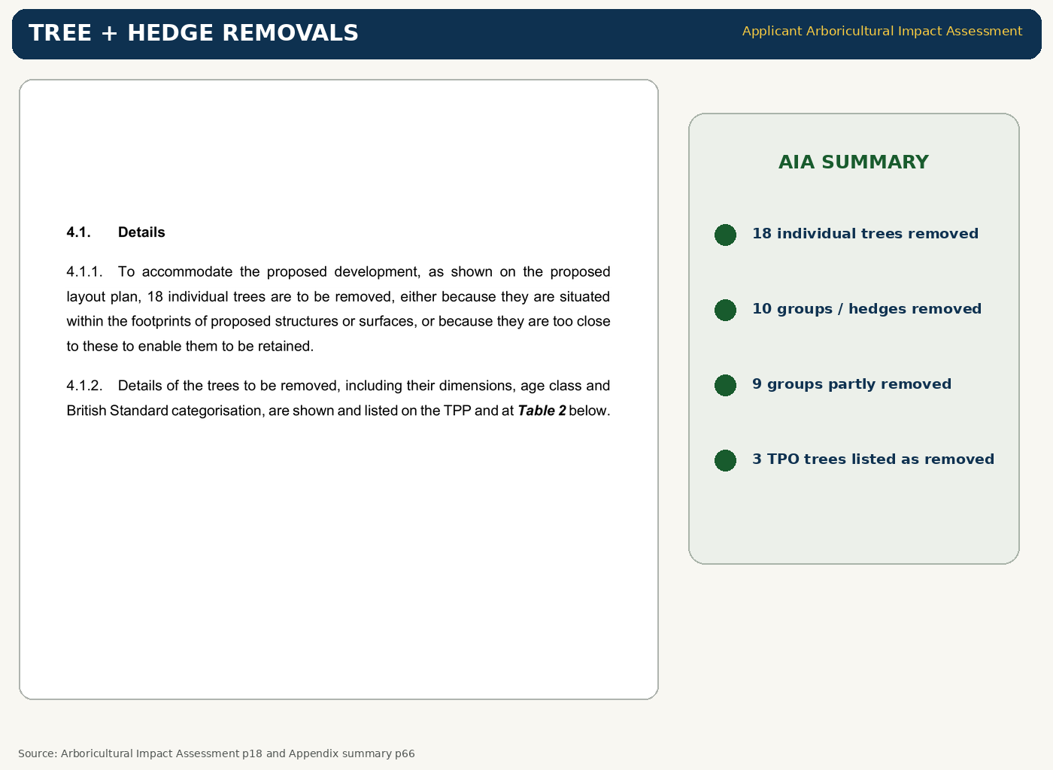
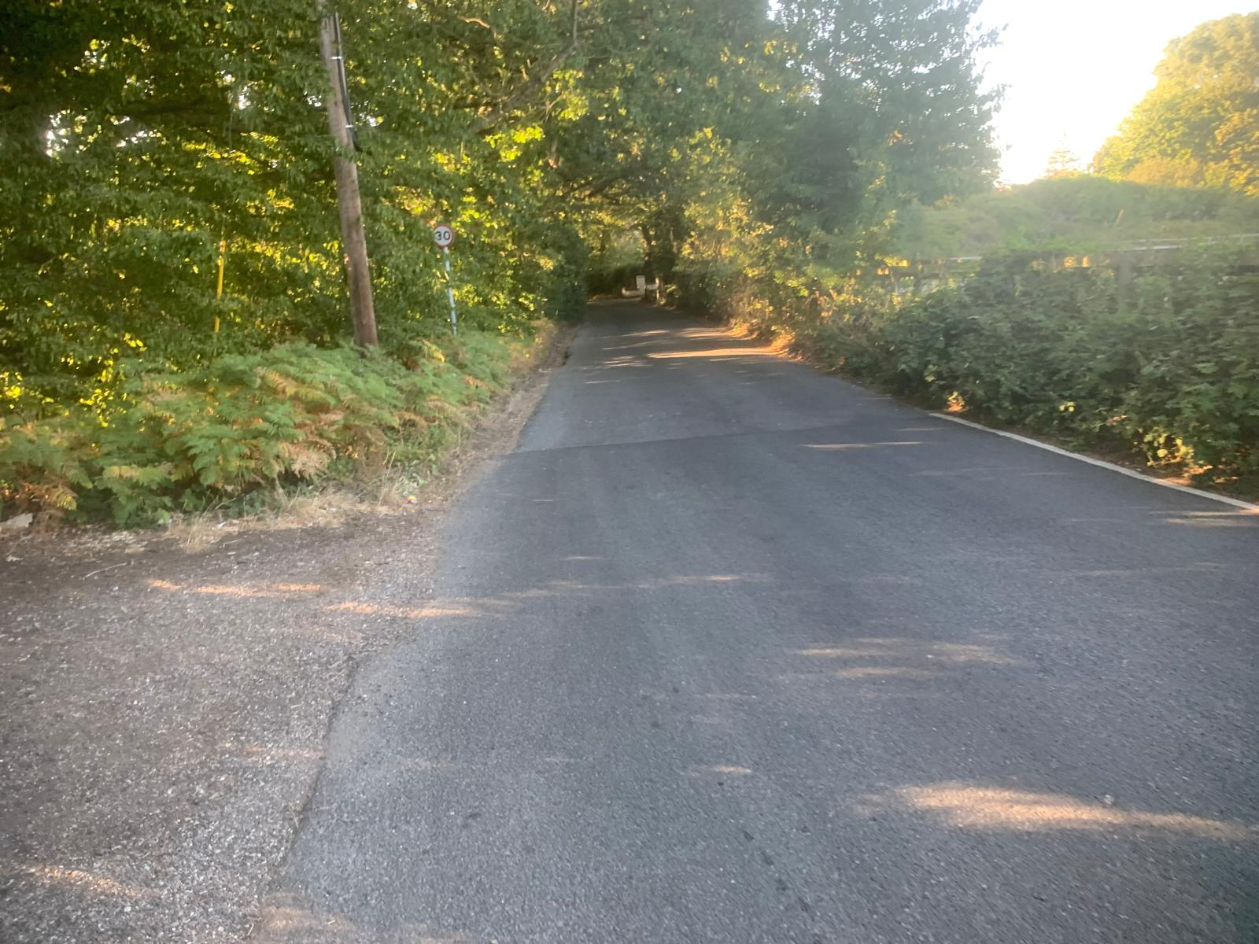
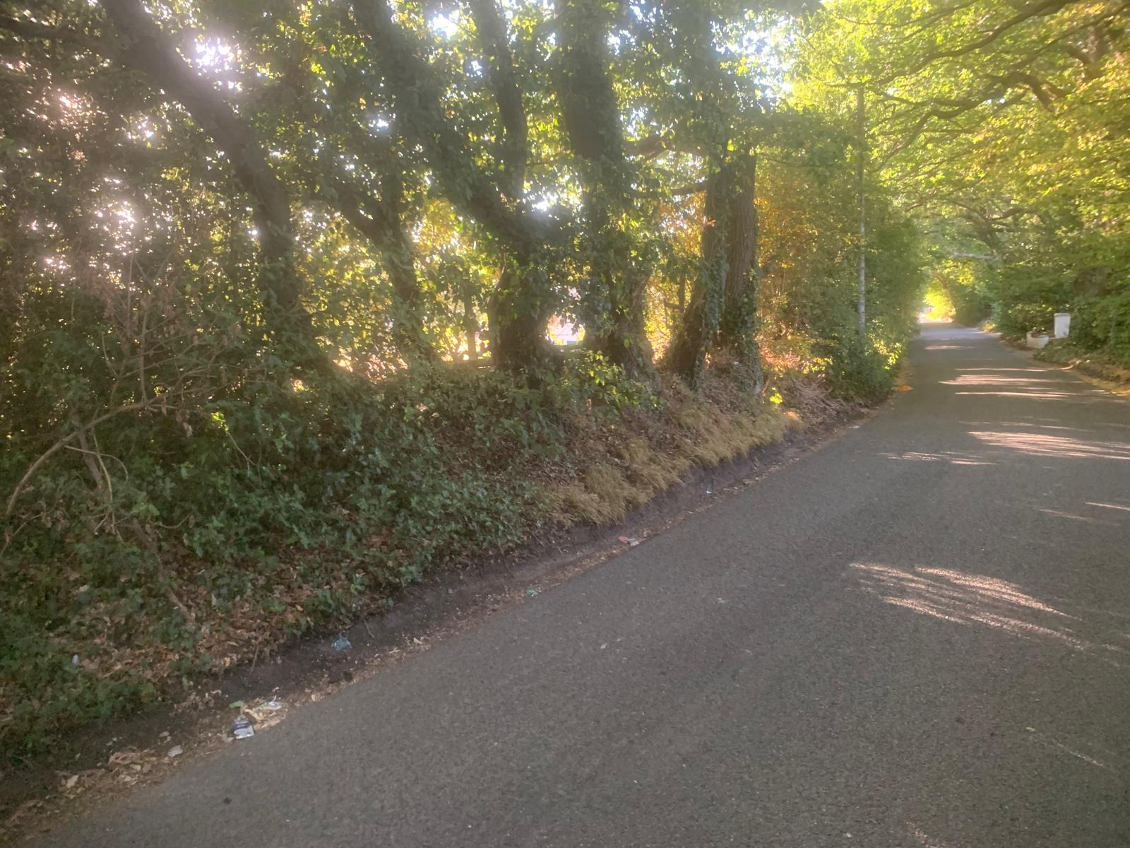
TREES + HEDGEROWS
27 / 34
• 18 individual trees removed
• 10 tree/hedge groups removed
• 9 groups partly removed
• Established landscape takes time to replace

Slide 29
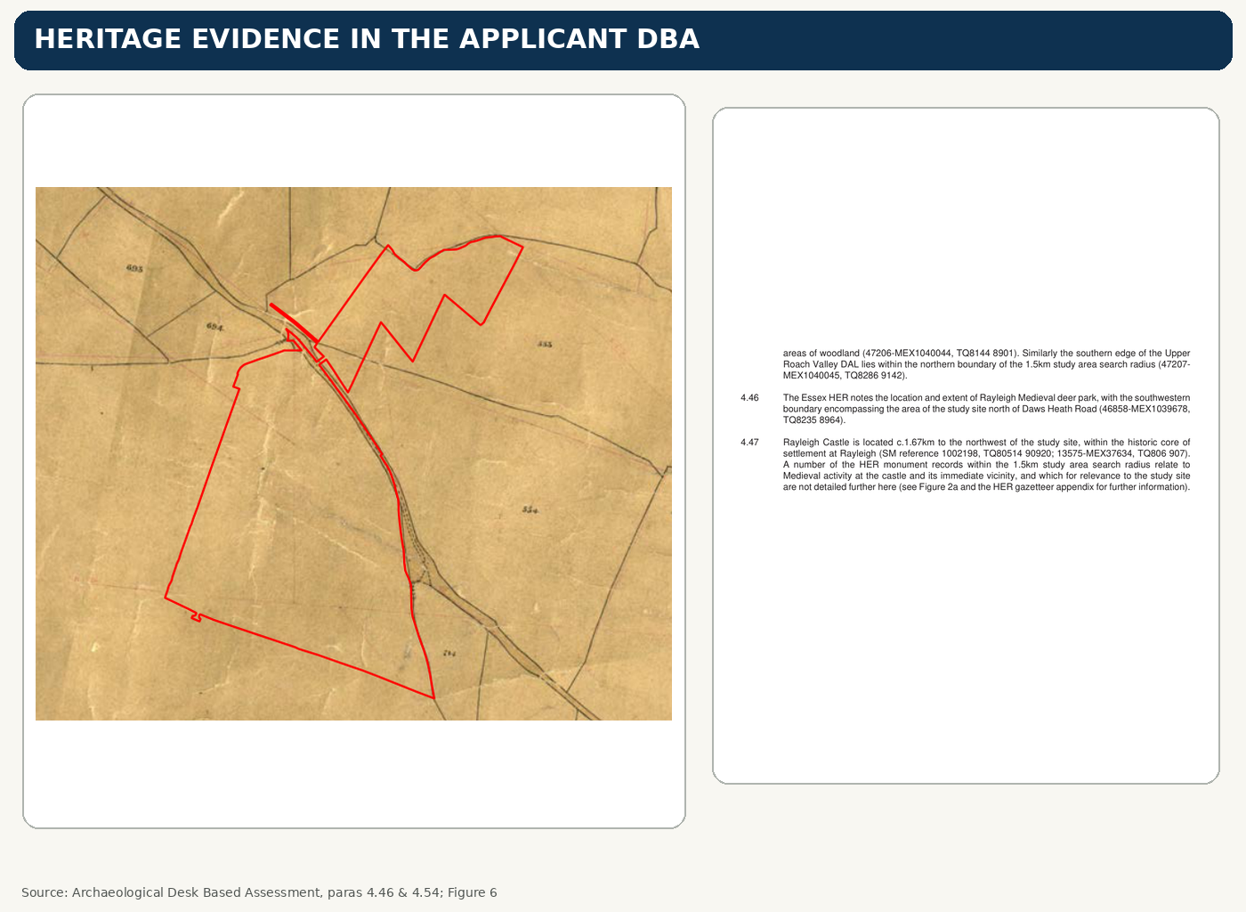
HERITAGE BEFORE DAMAGE
28 / 34
• Farmstead footprint
• 1840s mapping
• Boundary banks
• Possible water-management landscape
Wyburns Area Residents - public meeting presentation

Slide 30
WHAT WE ASK THE COUNCIL
29 / 34
• Pause and reassess
• Address Eastwood Brook
• Use fair parcels
• Consider heritage
• Do it before submission
Wyburns Area Residents - public meeting presentation

Slide 31
HOW TO OBJECT
30 / 34
• Use planning reasons
• Quote 26/00538/FUL
• Add your own evidence
• Stay factual
Wyburns Area Residents - public meeting presentation

Slide 32
OBJECTION GROUNDS 1–3
31 / 34
• Green Belt
• Highways + HGVs
• Flooding + drainage
Wyburns Area Residents - public meeting presentation

Slide 33
OBJECTION GROUNDS 4–6
32 / 34
• Ecology + landscape
• Heritage + archaeology
• Sustainability + infrastructure
Wyburns Area Residents - public meeting presentation

Slide 34
COUNCILLOR EMAIL
33 / 34
• Support WAR statement
• Ask for reassessment
• Raise at next committee
• Do not wait for Inspector
Wyburns Area Residents - public meeting presentation

Slide 35
STANDING TOGETHER
34 / 34
• Our countryside
• Our Green Belt
• Our community
• Our future
Wyburns Area Residents - public meeting presentation

